Slide 1
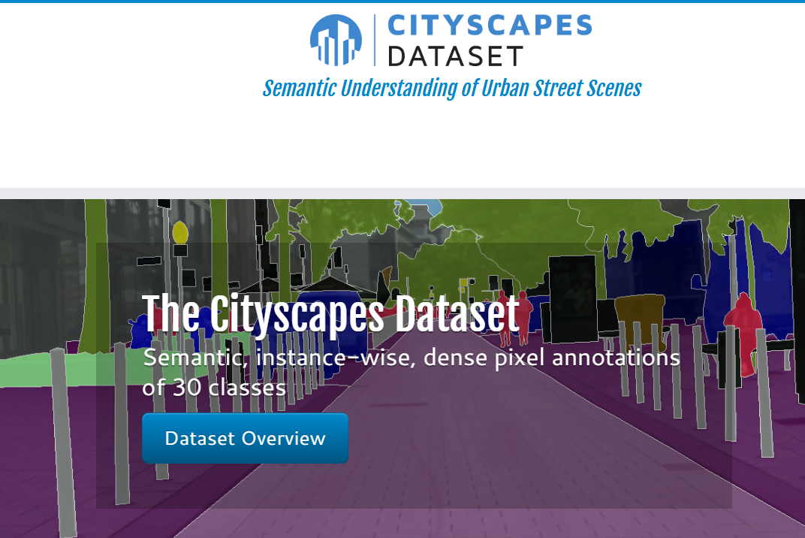
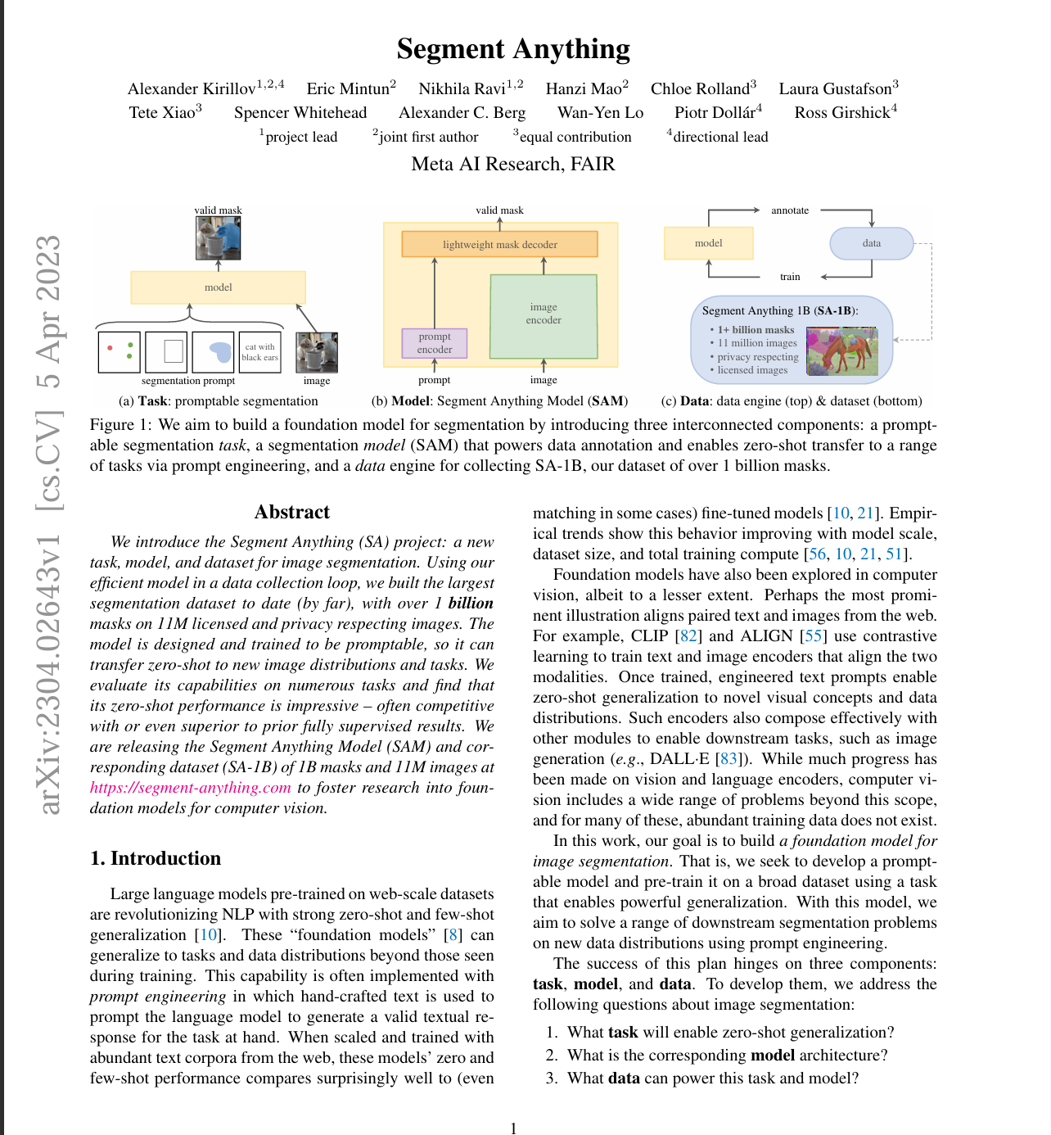
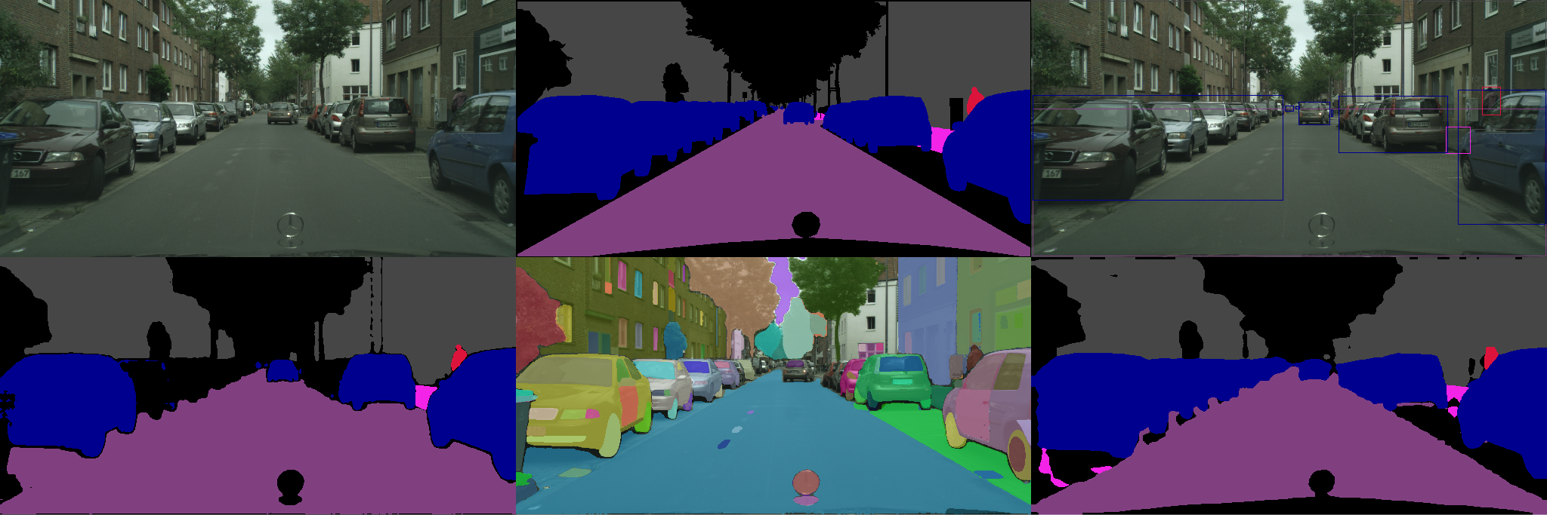
Segment Anything Model (SAM) for Cityscapes
Team 10: Erik Perez, Oluwatobiloba Olawore, Derek Owen

Slide 2
Motivation and Task
Image segmentation underpins many tasks:
Scene understanding, autonomous driving, AR, image editing.
Typical segmentation models:
Trained for one dataset or one task.
Require large, expensive pixel-level labels.
Goal of Segment Anything (SAM):
Promptable segmentation that can generalize across tasks and datasets.
Our focus:
Evaluate SAM on urban driving scenes from the Cityscapes dataset.
Study domain adaptation: can a Cityscapes-tuned SAM head beat a strong zero-shot baseline?

Slide 3
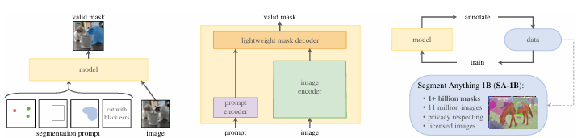
Segment Anything
Novel task: Promptable Segmentation
Given an image and a prompt, SAM returns a valid segmentation mask for any image.
Prompts: points, bounding boxes, masks, text (in follow-up work)
Segment Anything Model (SAM)
MAE-pretrained ViT-H image encoder.
Prompt encoder for points, boxes, masks.
Lightweight mask decoder that fuses image and prompt tokens
SA-1B dataset
~1.1B masks on 11M images
Model-in-the-loop annotation pipeline

Slide 4
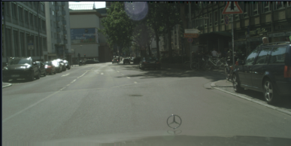
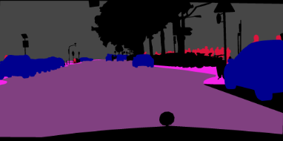
Our Downstream Task
Dataset:
Cityscapes: 2,975 train and 500 val segmented images of urban street scenes into 19 classes
Downstream task:
Segmentation of urban driving scenes
Focused on only 5 classes: road, sidewalk, car, person, building
Research question: “How does domain adaptation affect SAM’s performance?”
Zero-shot SAM on Cityscapes vs. Cityscapes-tuned SAM with a new semantic head
Evaluation metrics
Intersection-over-Union of each class
Mean Intersection-over-Union (mIOU)

Slide 5
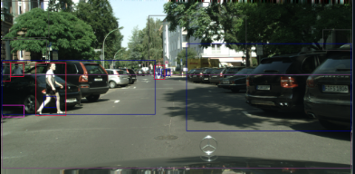
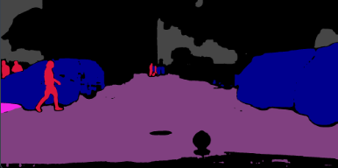
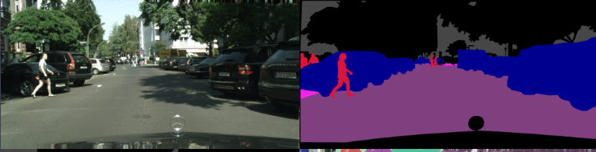
Zero-Shot SAM Baseline
Box-Prompt Generation
Extract ground-truth masks from Cityscapes
Sample tight bounding boxes around class regions
Using SAM
Use pretrained weights checkpoint from SAM’s Github
Feed boxes to SAM’s box prompt interface using SamPredictor
Interpret SAM’s output and segment image
Result: 0.7192 mIoU

Slide 6
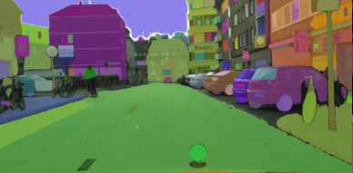

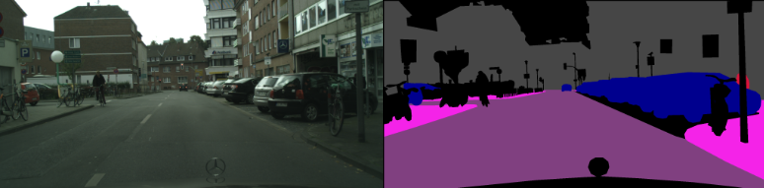
Our Cityscapes-Tuned SAM Head
Use SAM’s image encoder as a frozen generic feature extractor
Attach a lightweight semantic head that predicts 6 classes:
Road, sidewalk, building, person, car, or “none of the above”
Head architecture: Two 3x3 convolutional layers, batch normalization, ReLU layers
Training
Loss: cross-entropy
Optimizer: Adam
Learning rate: 1e-3, Epochs: 5, Batch size: 2
Trained on all 2975 images, evaluated on all 500 images
RTX 3080 GPU, ~4 hours
Result: 0.8013 mIoU

Slide 7
Quantitative Results
Box-prompt zero-shot SAM baseline
mIoU: 0.7192
Per-class IoU
road: 0.8544
sidewalk: 0.6984
building: 0.6944
person: 0.6114
car: 0.7374
SAM-based Cityscapes-tuned semantic head
mIoU: 0.8013
Per-class IoU
road: 0.9256
sidewalk: 0.6990
building: 0.8535
person: 0.6555
car: 0.8731

Slide 8
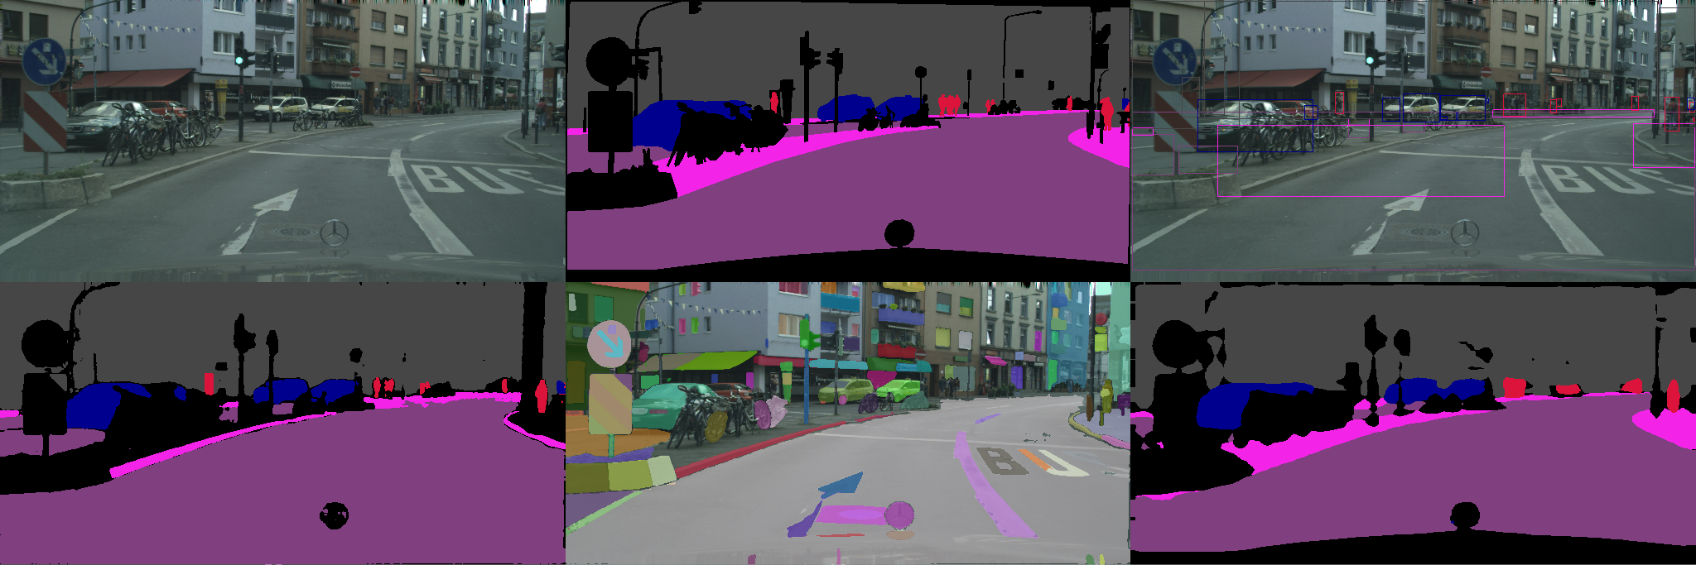
Qualitative Results

Slide 9
Analysis and Discussion
Why did the tuned head get better results?
Tuned head was trained on the same dataset it was tested on
SAM is only as good as its prompt and good prompt generation is not easy
SAM is strong at single-object masks with high-quality prompts
While the tuned head’s output is not as sharp, it “understands” the task better than SAM and scores higher on IoU, so SAM domain adaptation is a worthwhile project for specific downstream tasks
However:
SAM’s zero-shot results are impressive and with better prompts it could perform better than our model

